Slide 1
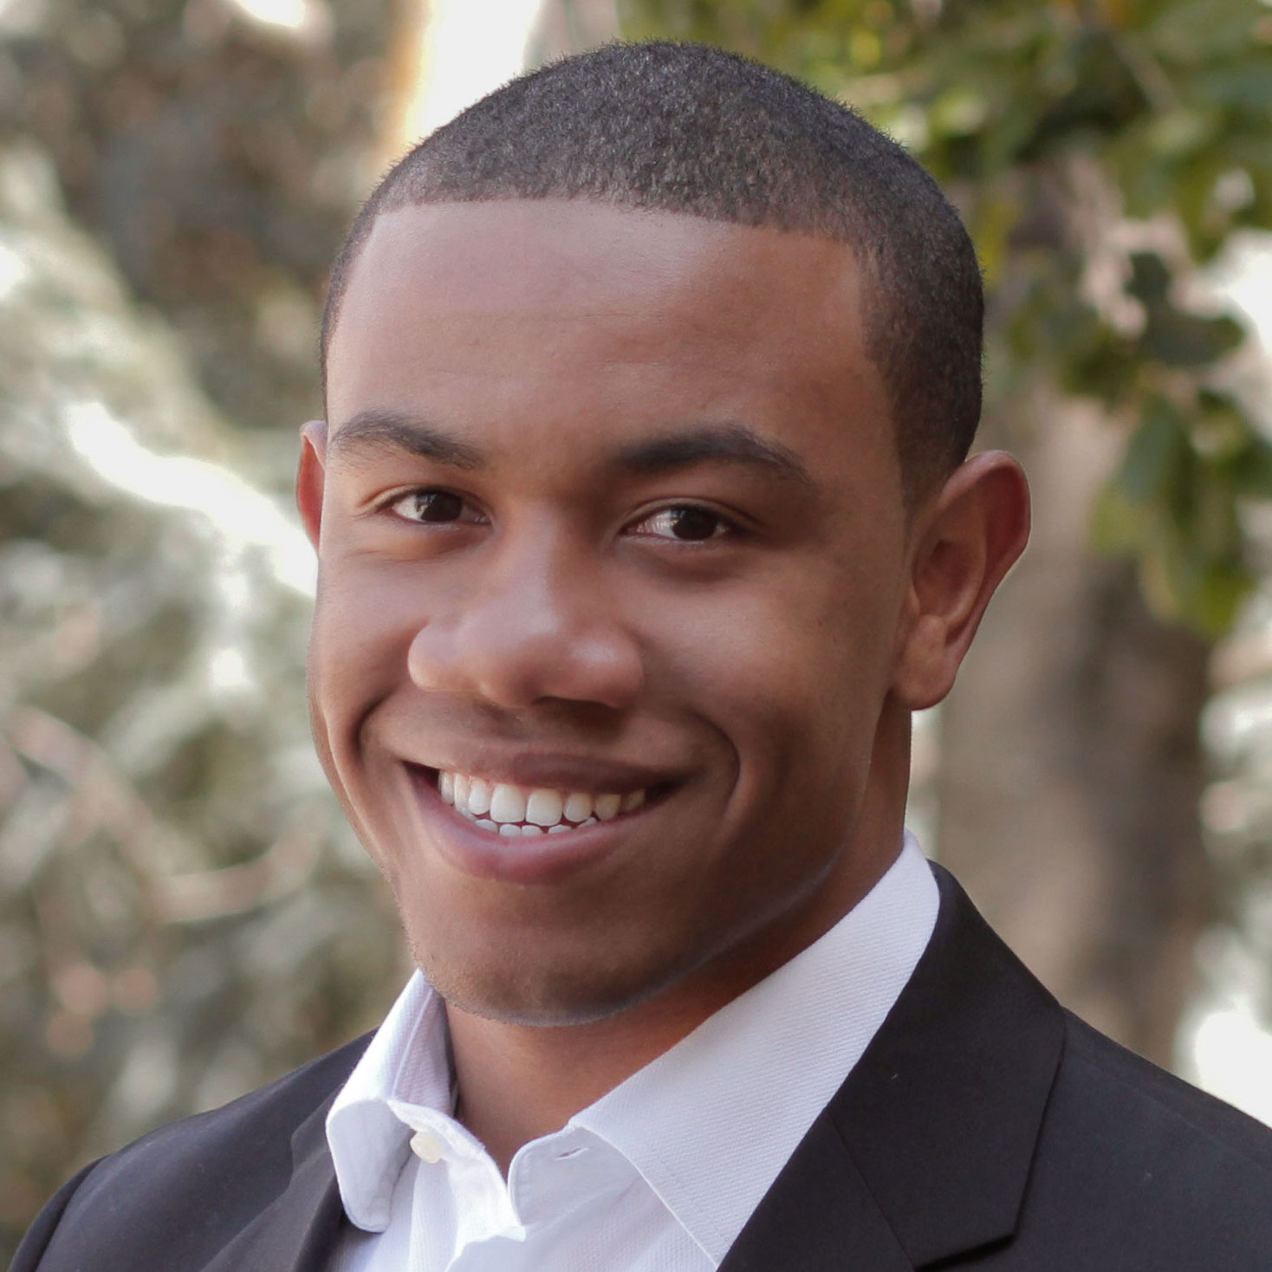


Medium-Fi Prototype
Team: Laura Brouckman, Matthew Chen, Leslie Kurt, Saamon Legoski
Studio: Digital Democracy
Presenter: Leslie Kurt
Notes:
Hi, I am leslie kurt and this week I will be presenting on behalf of my group, DeBias. This week we worked on the medium-fi prototype. Last week we made the low-fi paper prototype during our user testing and section we got a lot of really good feedback that helped us to improve our concepts and the app as a whole.

Slide 2
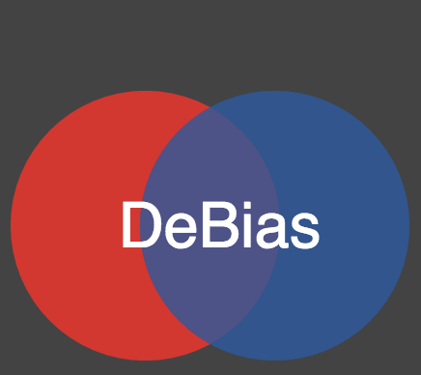
Mission Statement
Diversify your news!
Notes:
Old : “DeBias yourself with diverse news sources!”

Slide 3
Tasks
Notes:
So moving on to the 3 main tasks of DeBias, we have actually kept the same tasks from our low-fi prototype.

Slide 4
Set
goals for
quantity/ diversity
of articles
Simple
Notes:
So to reiterate what they were, our simple task is for users to set goals for the quantity and diversity of articles to read each week. The user will input that they want to read 2 very conservative, 3 conservative, 4 neutral, 2 liberal, and 2 very liberal articles each week and the app will track their progress on this.

Slide 5
Set
goals for
quantity/ diversity
of articles
Simple
Medium
Compare and compete
with other users
Notes:
Our medium task, is to have users compare and compete with other users. So this involves friends section of our app which includes a ranking system of the user with their friends to show them how they compare to their friends in quantity and diversity of articles. This task serves to motivate the user to improve their rankings as well as hold them accountable to the articles they are reading.

Slide 6
Set
goals for
quantity/ diversity
of articles
Simple
Medium
Compare and compete
with other users
Ensure that the user is
aware of their own biases
Complex
Notes:
This leads us to our complex task, which serves as the foundation of our app and that is to ensure that the user is aware of their own biases. It is really easy for people to see the baises in other people, but really hard to make someone aware of their own biases. This is why we view this as our complex task in that it takes a lot of interaction and visuals to help the user come to this realization that they too are biased. Our visuals include a series of graphs, including a pie chart and bar graph.

Slide 7
UI Changes
Notes:
While the tasks are the same from our low-fi prototype, we made somer ui changes from our low-fi prototype to our medium-fi prototype.

Slide 8
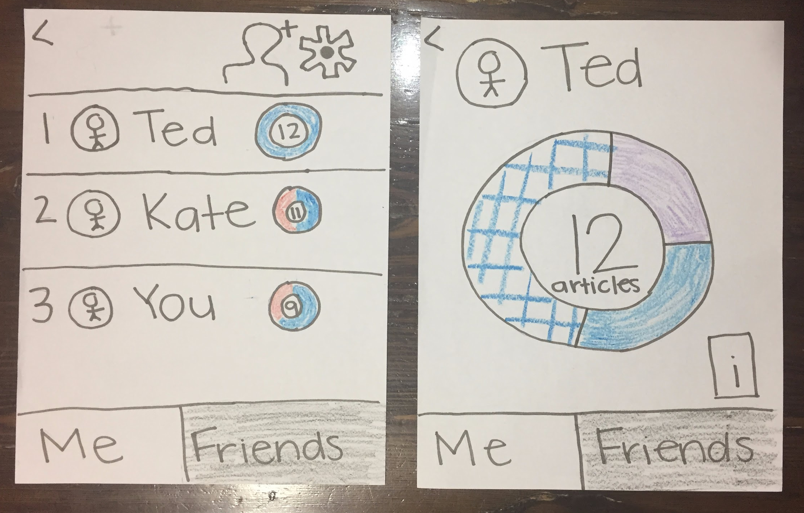
UI Change #1:
View Friends’ Articles
Notes:
The first change was on the amount of information a user could see about their friends. During the user testing last week, we had a couple participants click on Ted’s pie chart expecting to get their articles because this was the interaction they had learned from their own pie chart. And during the low-fi prototype testing, we didnt have a screen to give them so clicking on the pie-chart did’t do anything.

Slide 9
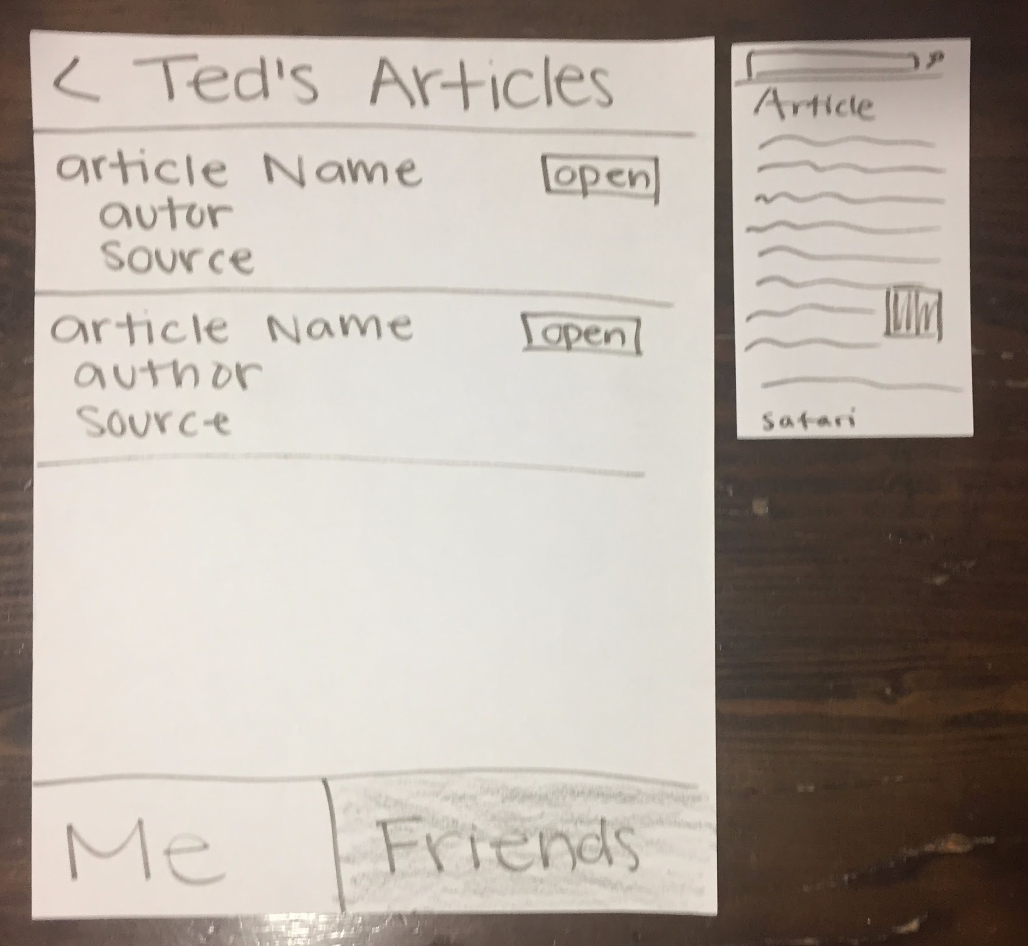
UI Change #1:
View Friends’ Articles
Notes:
So we decided that it would be helpful for the user to be able to see the more indepth breakdown of their friends. For one it could give them inspiration on what articles to read as well as help them to better understand the rankings.
However this brought up another aspect of apps and that is privacy. Some users might not be comfortable with other users viewing this more in-depth breakdown of what they are reading.

Slide 10
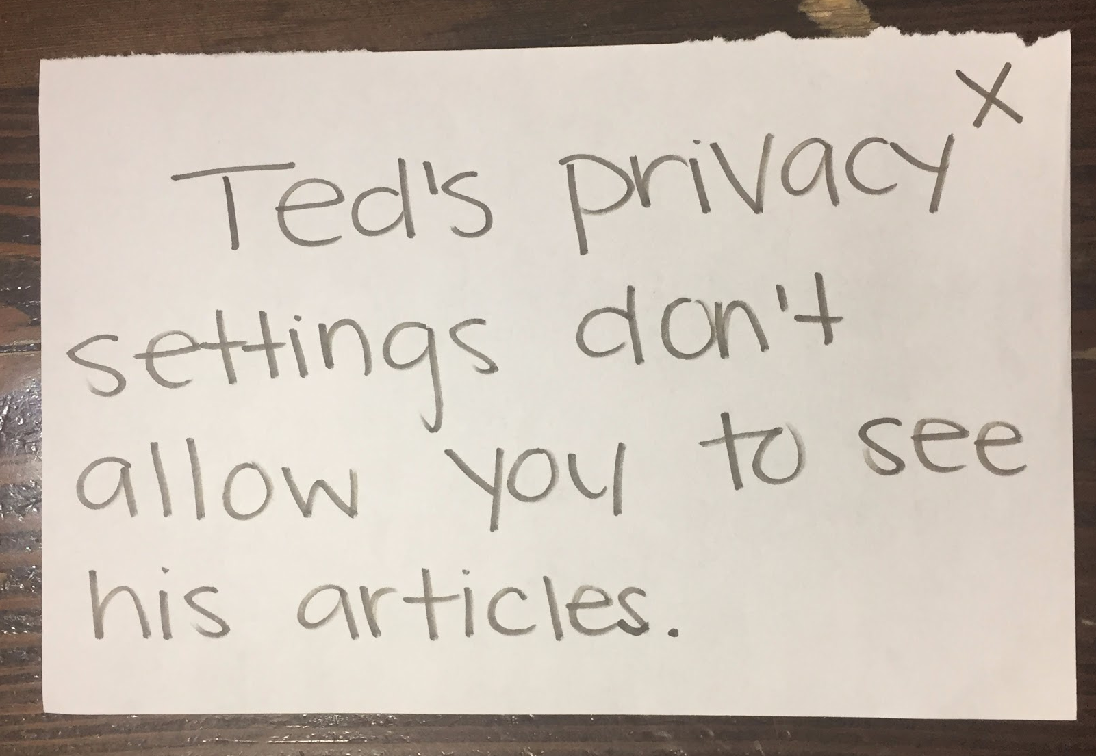
UI Change #1:
View Friends’ Articles
Notes:
So to respect the users privacy we are also adding a setting that would allow a user to block their friends from viewing this in-depth information. If the user turned on their privacy settings, they would be given this pop-up message rather than being able to view the articles.

Slide 11
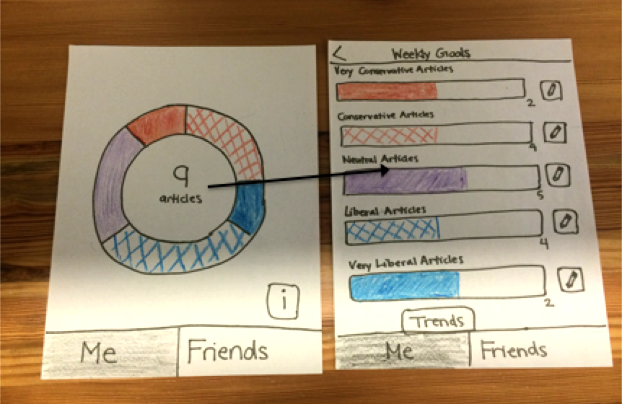
UI Change #2
Badges Screen
Notes:
Our second, revolved around giving the user more personal motivation to improve their rankings. So this was our original home screen and weekly goals and you will notice that the trends button is here to help the user visualize their own data, but ...

Slide 12
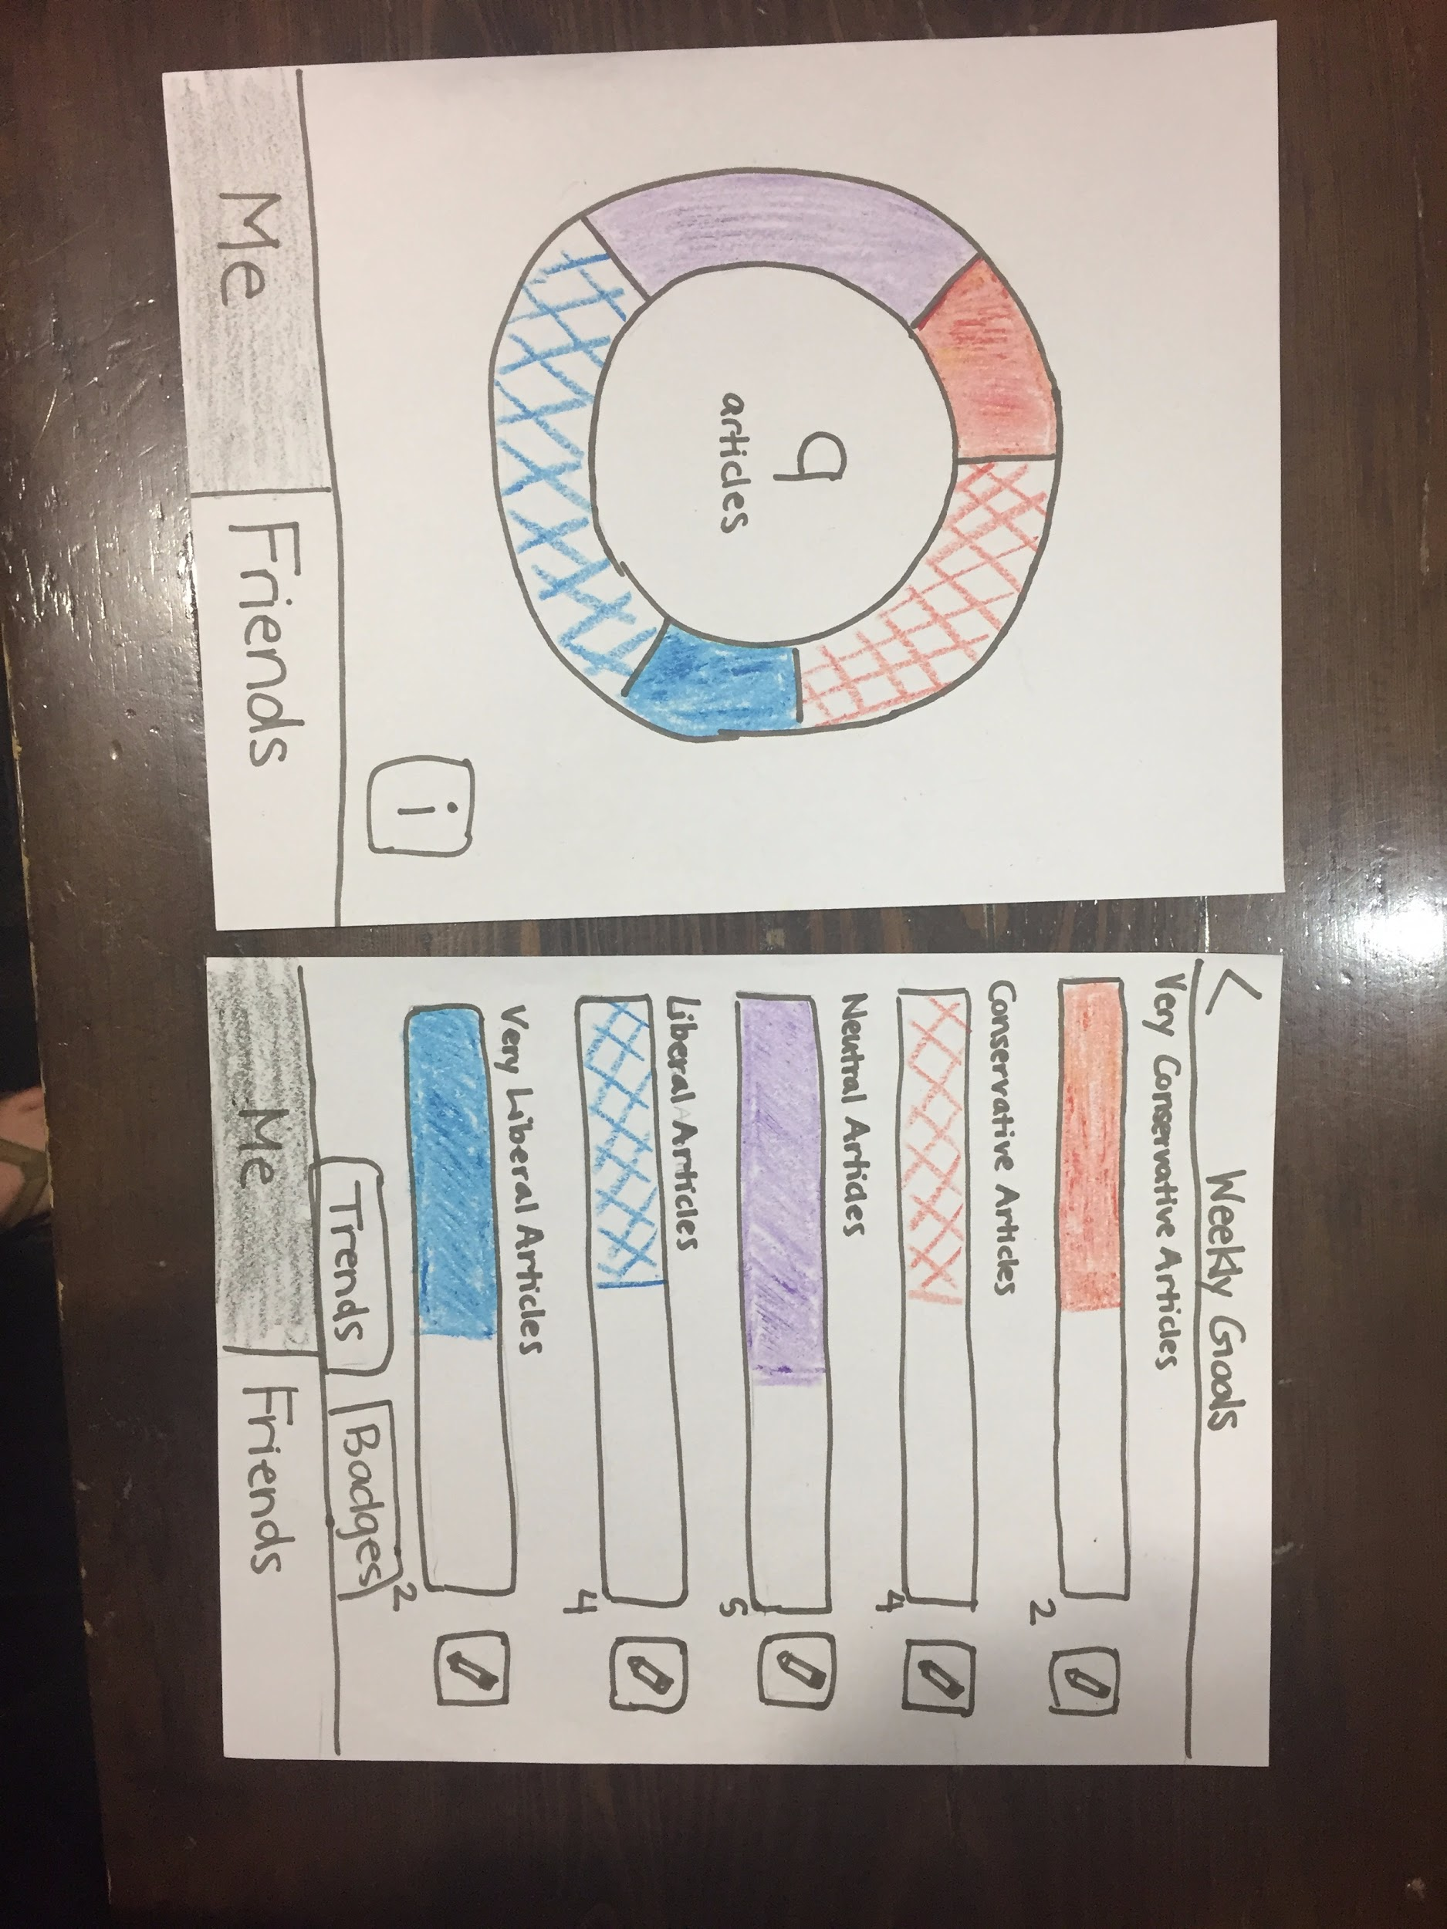
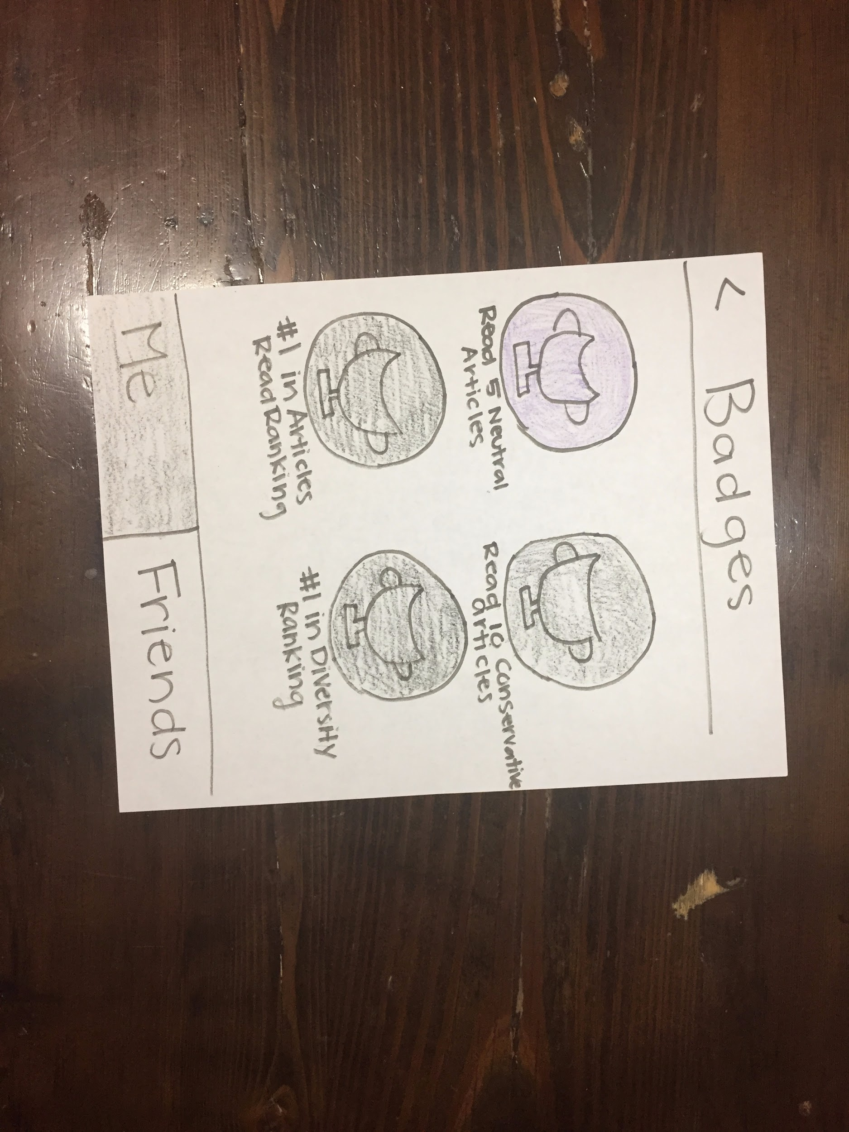
UI Change #2
Badges Screen
Notes:
If you notice now there is now a badges button next to the trends button and this links to this screen here. So some of the badges include “reading 5 neutral articles”, “being 1st in the articles read ranking”. And this ui change was inspired by suggestions made in section, so thank you! And we think that it adds another visual tool for users to see their progress.

Slide 13
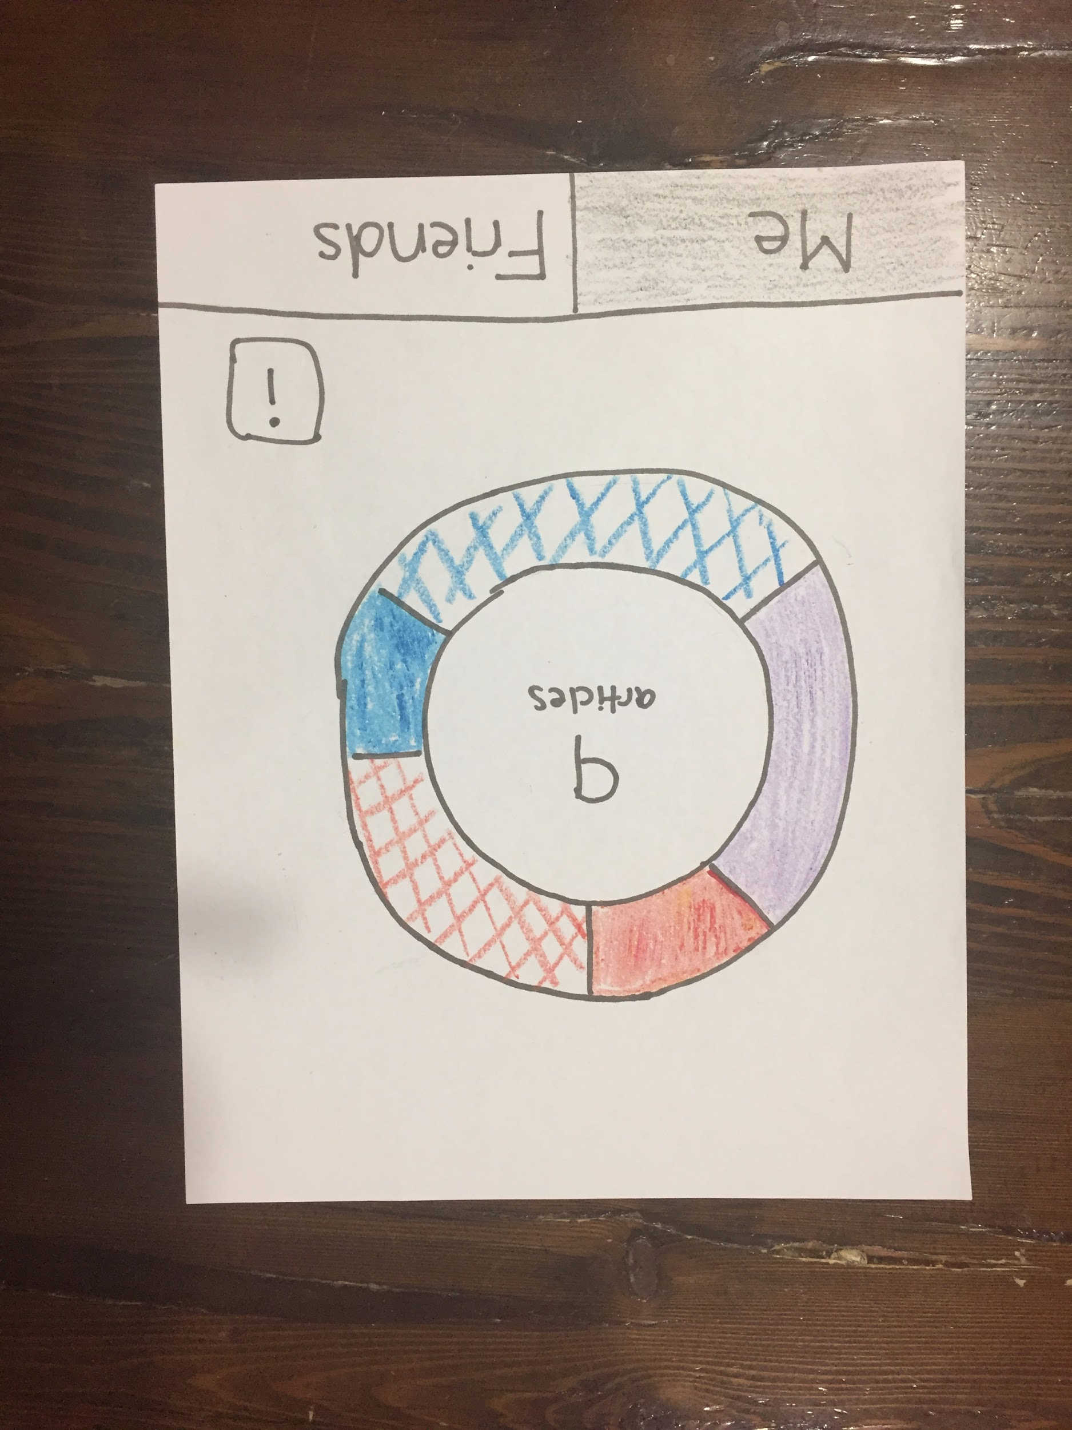
UI Change #3
Updated home screen with new key and settings page
Notes:
Our third ui change was on the home screen. During ui testing we got feedback that the user wouldn’t click on the i to recieve the information about the color wheel.

Slide 14
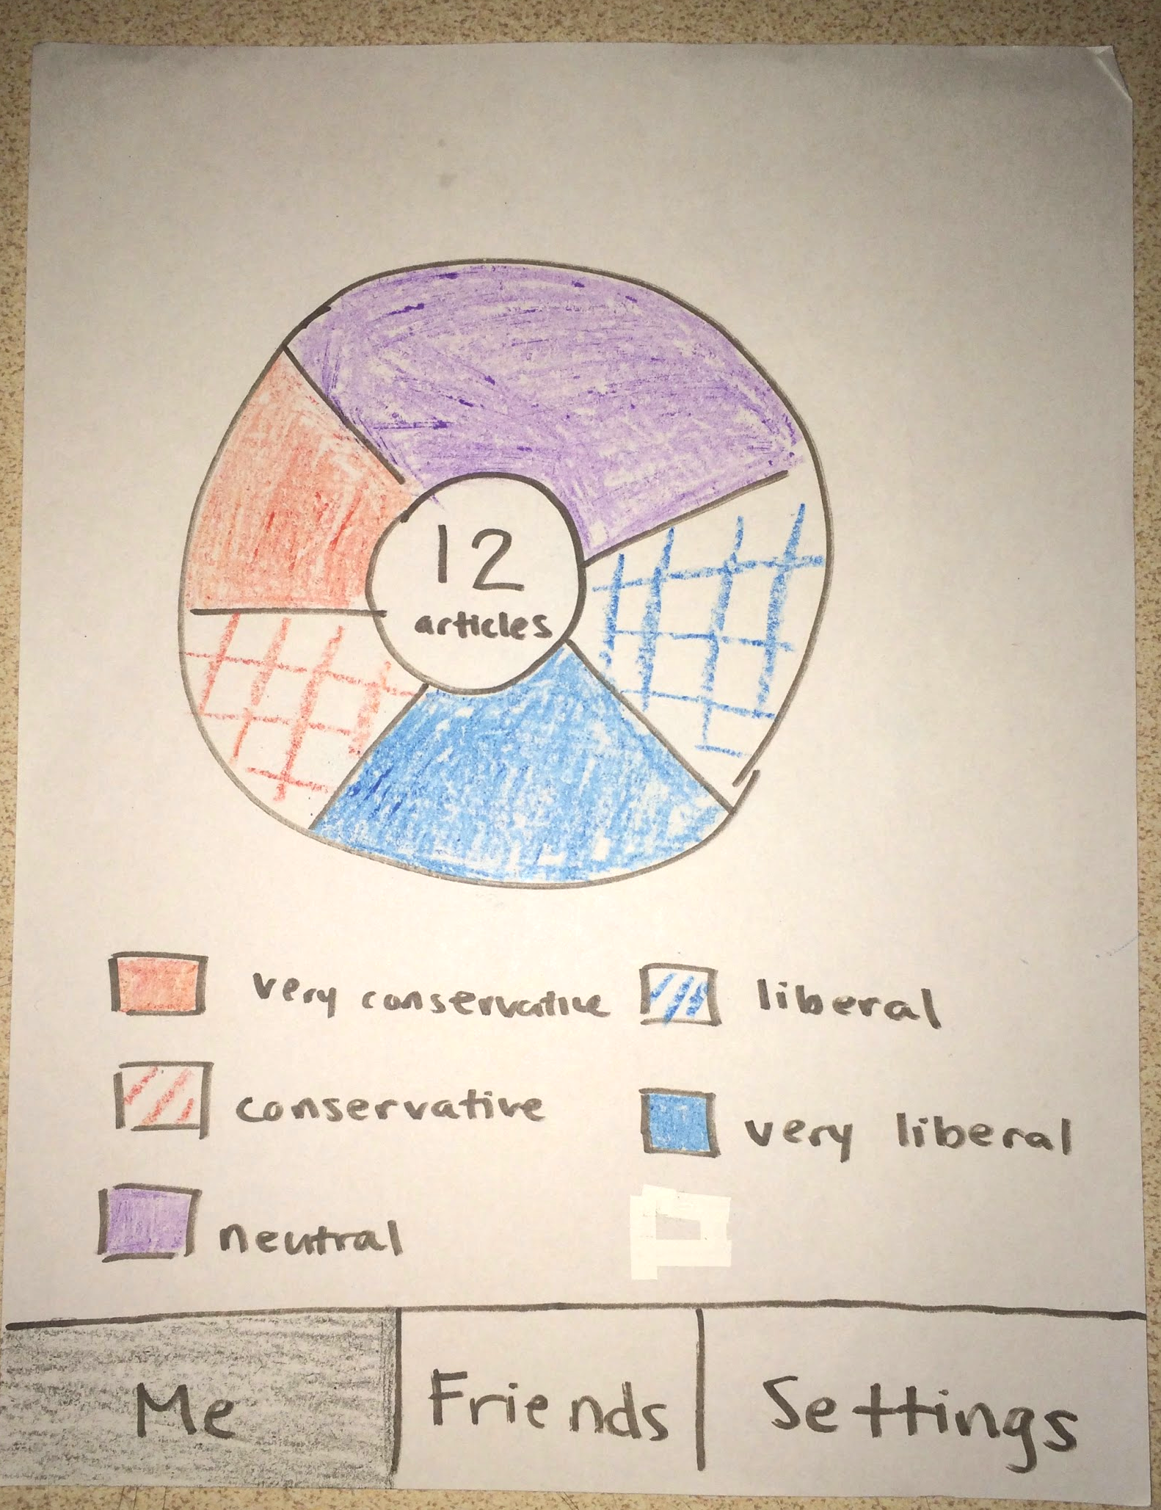
UI Change #3
Updated home screen with new key and settings page
Notes:
So what we decided was to put the key right on the page so that the information is readily avaliable to them. You will also notice that the bottom toolbar changed to add a settings tab.

Slide 15
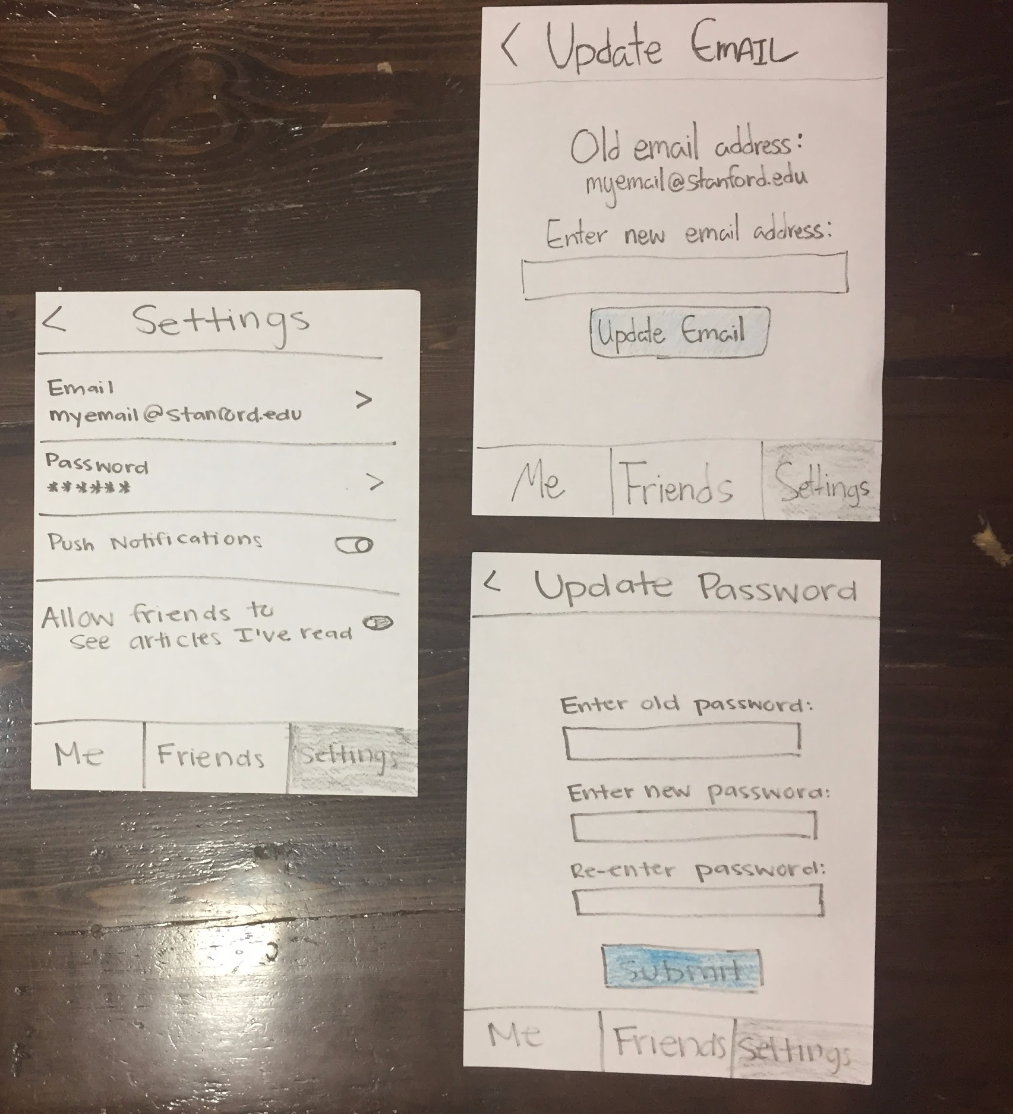
UI Change #3
Updated home screen with new key and settings page
Notes:
So clicking on the settings button, it will take you to a screen where you can update your email, password, notifcation settings, as well as the privacy settings as to whether you want your friends to be able to view your in-depth profile (which was mentioned earlier in our 1st ui change)

Slide 16
Medium-Fi Task Flow

Slide 17
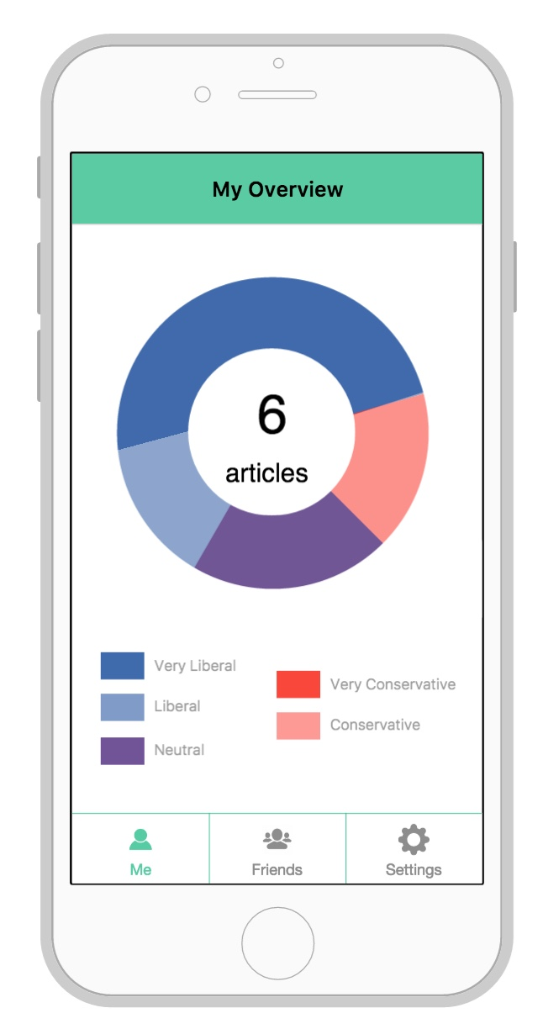
Medium-Fi Task Flow
Notes:
Me

Slide 18
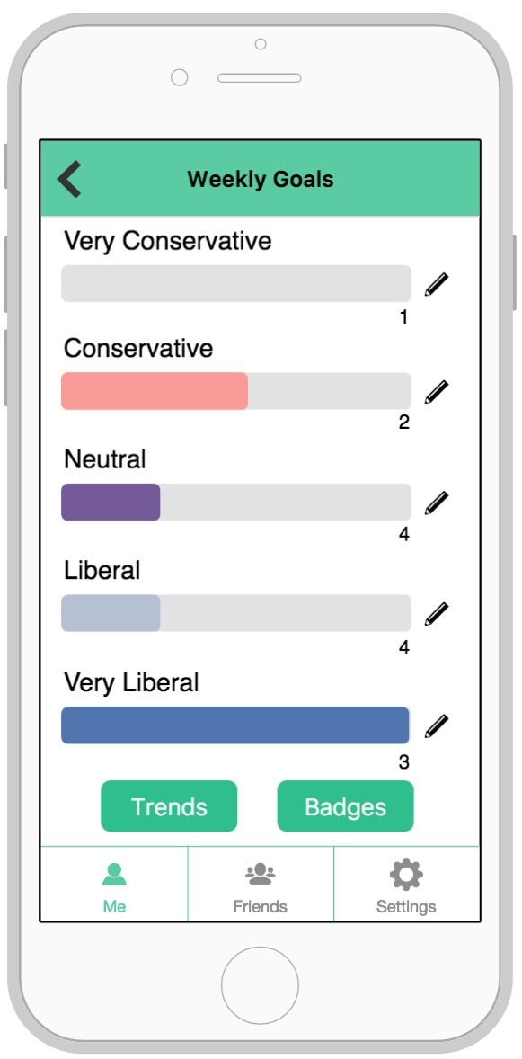
Medium-Fi Task Flow
Notes:
Me

Slide 19
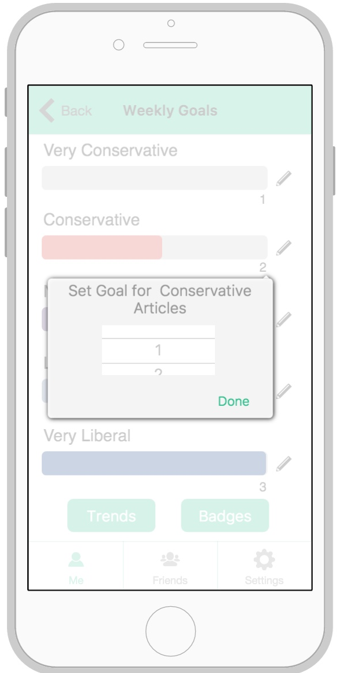
Medium-Fi Task Flow
Notes:
Me

Slide 20
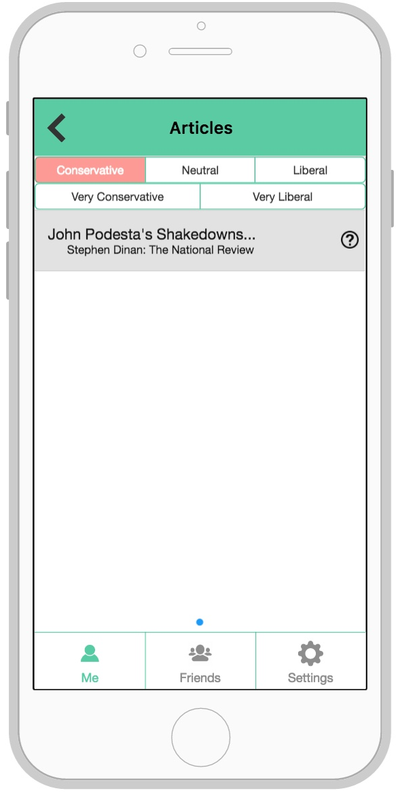
Medium-Fi Task Flow
Notes:
Me

Slide 21
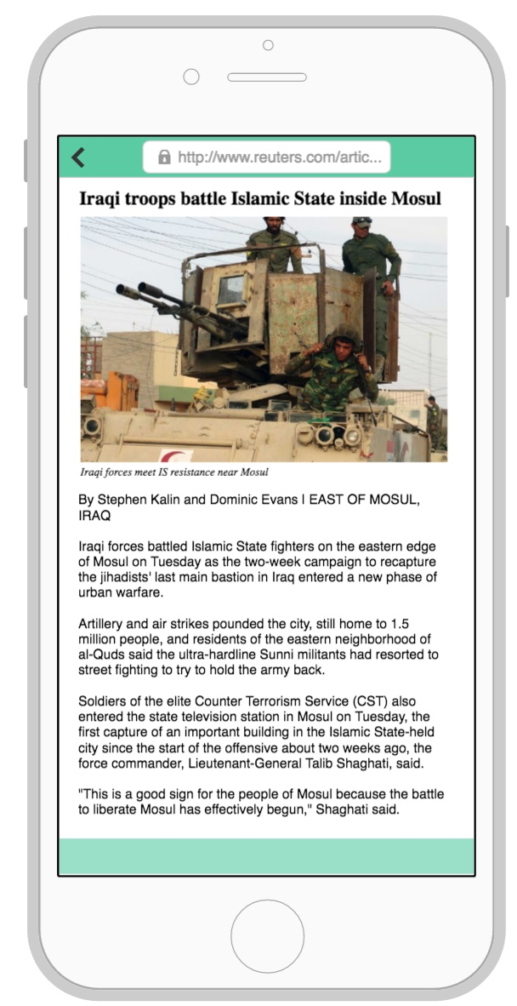
Medium-Fi Task Flow
Notes:
Me

Slide 22
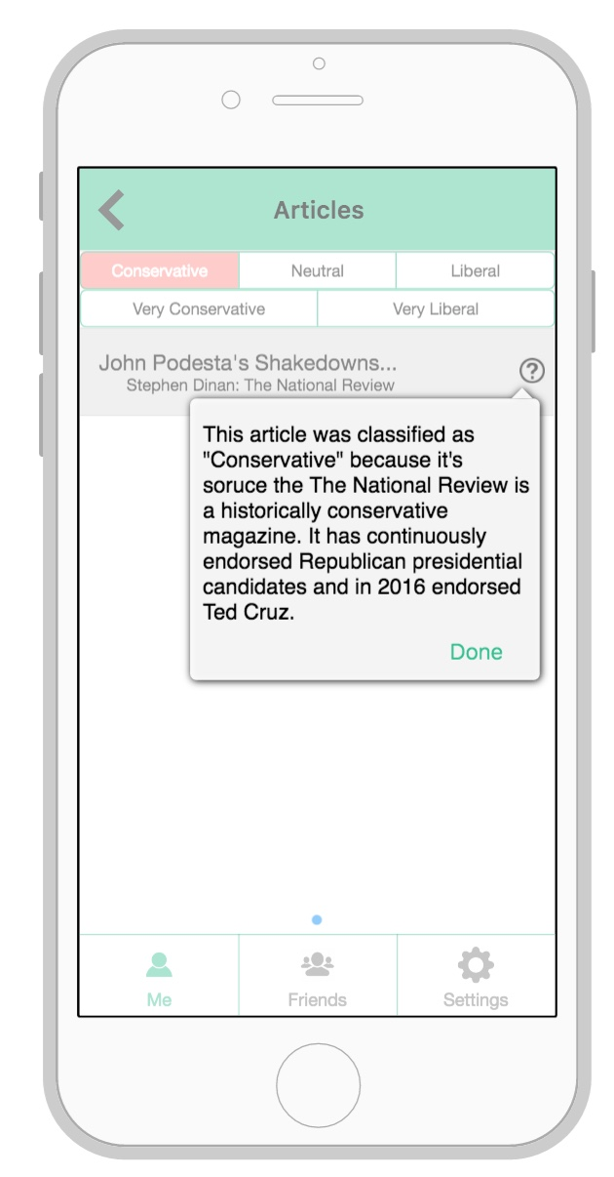
Medium-Fi Task Flow
Notes:
Me

Slide 23
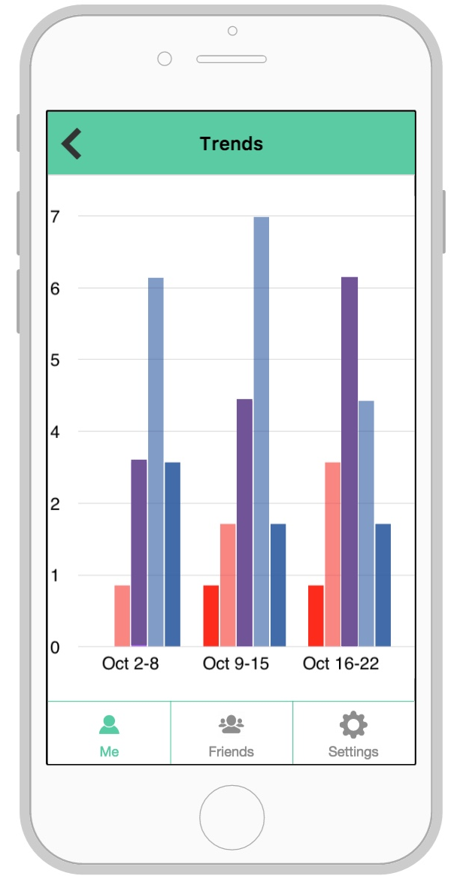
Medium-Fi Task Flow
Notes:
Me

Slide 24
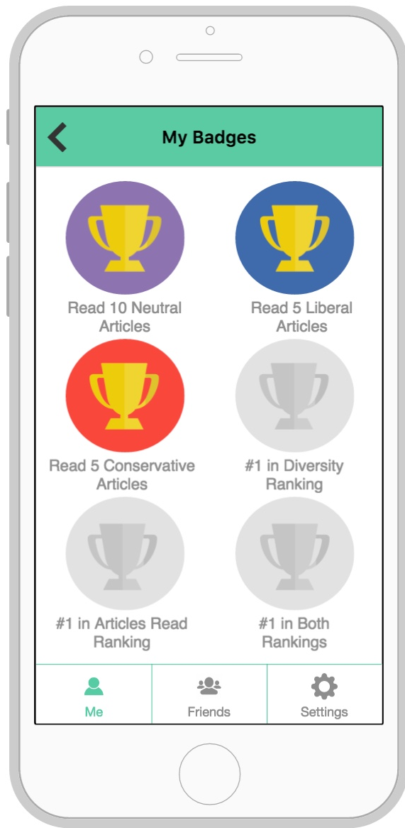
Medium-Fi Task Flow
Notes:
Me

Slide 25
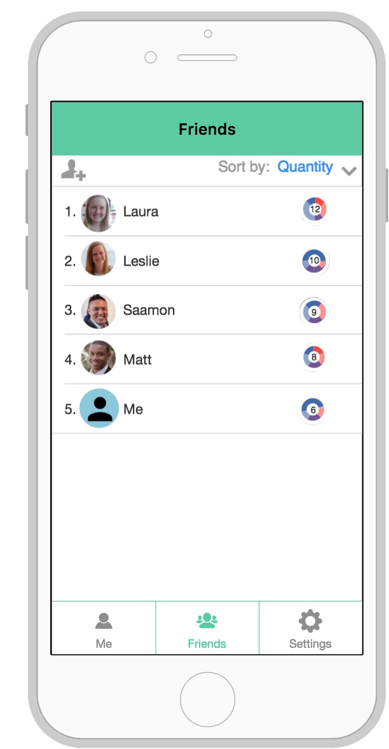
Medium-Fi Task Flow
Notes:
Friends

Slide 26
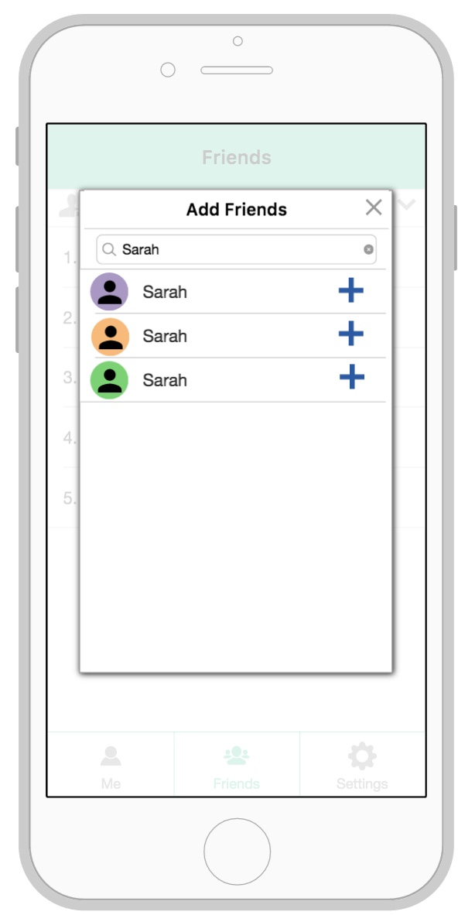
Medium-Fi Task Flow
Notes:
Friends

Slide 27
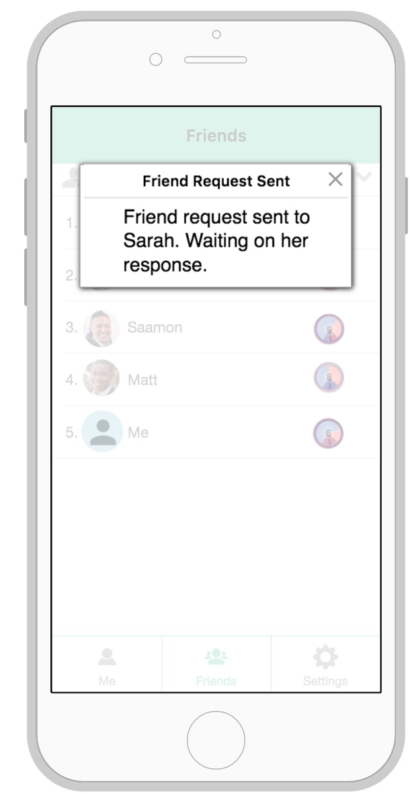
Medium-Fi Task Flow
Notes:
Friends

Slide 28
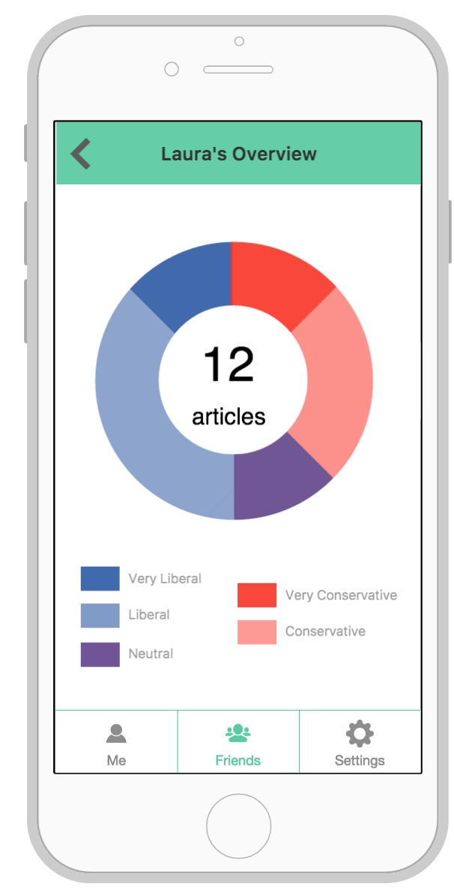
Medium-Fi Task Flow
Notes:
Friends

Slide 29
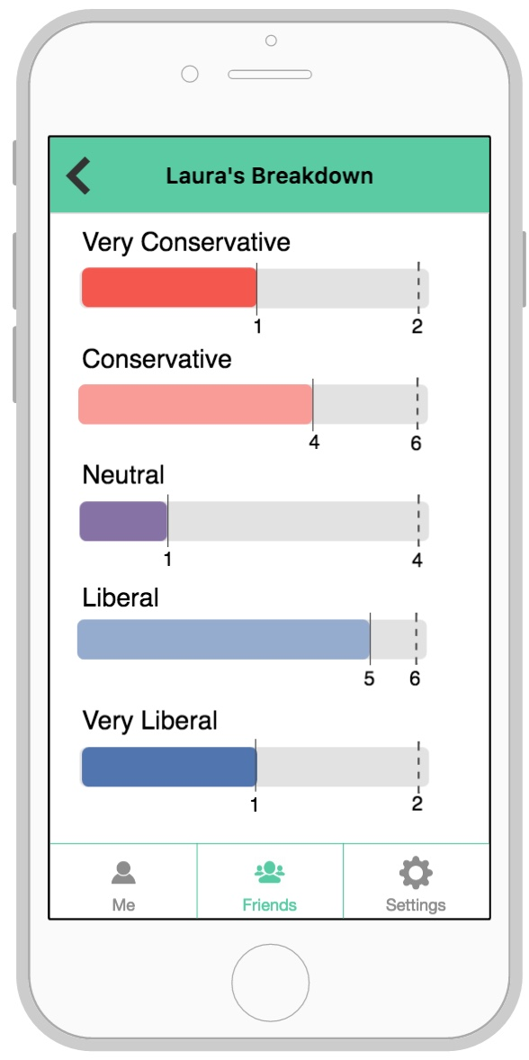
Medium-Fi Task Flow
Notes:
Friends

Slide 30
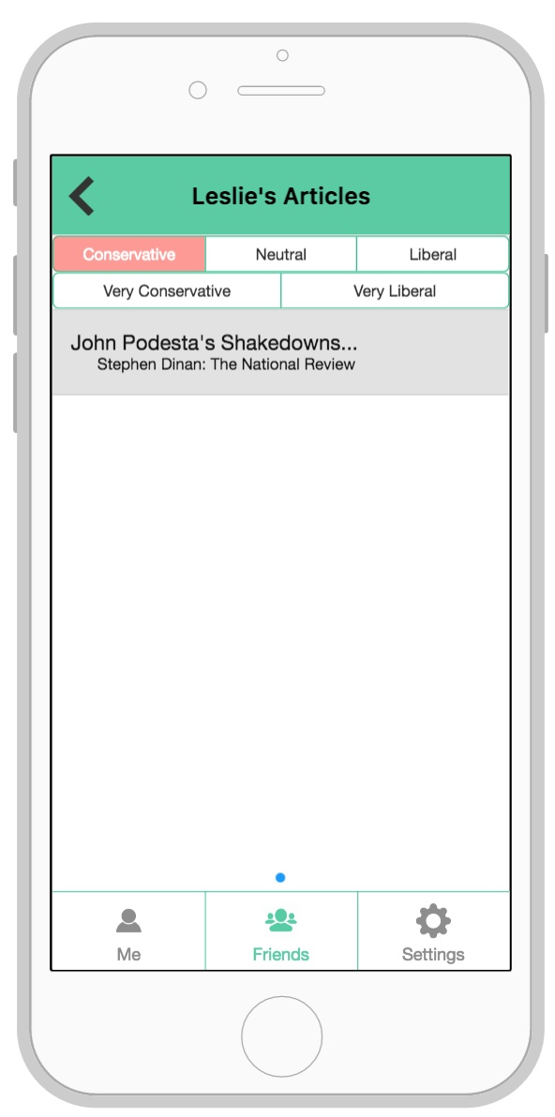

Medium-Fi Task Flow
Notes:
Friends

Slide 31
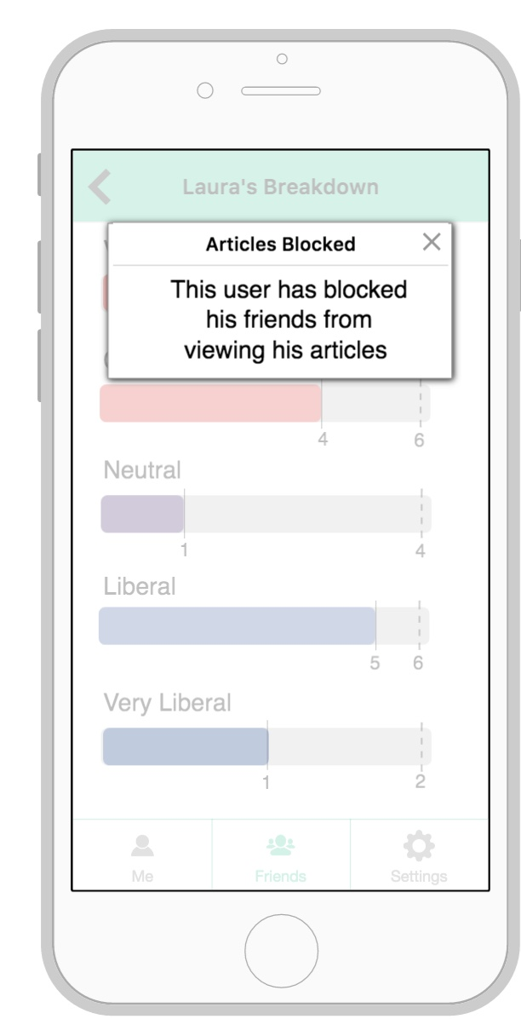
Medium-Fi Task Flow
Notes:
Friends

Slide 32
Medium-Fi Task Flow
Notes:
Settings

Slide 33
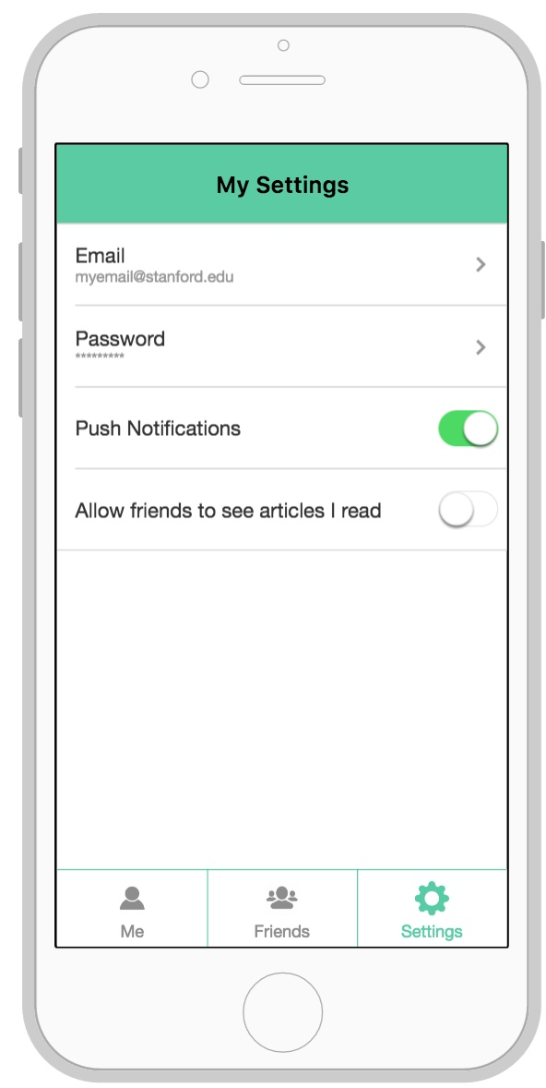
Medium-Fi Task Flow
Notes:
Settings

Slide 34
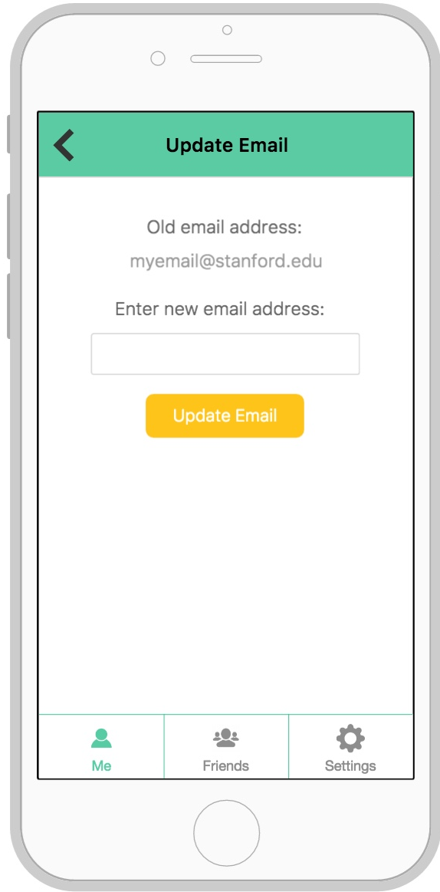
Medium-Fi Task Flow
Notes:
Settings

Slide 35
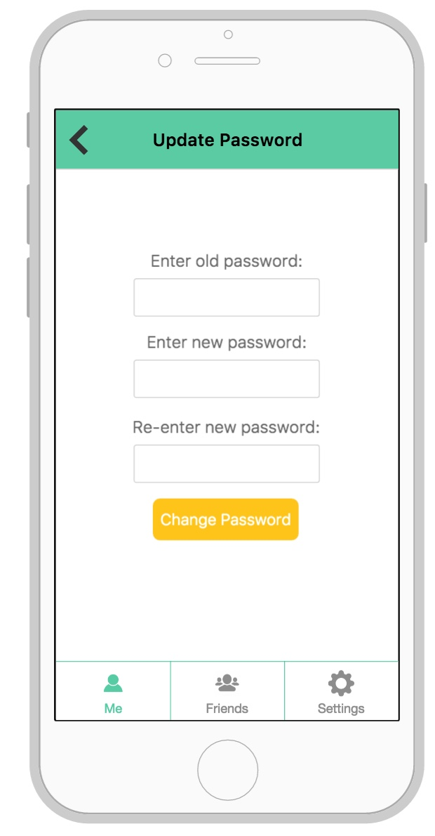
Medium-Fi Task Flow
Notes:
Settings

Slide 36
Prototype Tools
Proto.io
Easy drag-drop interface
Predefined iOS tools
Changes weren’t consistent across screens
Couldn’t create your own elements
Notes:
From sketches

Slide 37
Limitations/ Trade-offs
Basic variable functionality
No push notifications
Not all articles have classification description
No scrolling
Notes:
While proto.io has some variable functionality, it is not great, so parts of the app that usually would change remain fixed for our medium-fi prototype. For example, changing the goal for the number of articles to read will change the number displayed but not the width of the progress bar (there is a bug with dividing and multiplying variables in proto.io: https://support.proto.io/hc/en-us/community/posts/207859198-Slider-Variables).
The prototype does not update with new articles being read, so the information in it is static. Our real app will be changing constantly as the user and their friends read articles so it will change significantly over time.
The app does not support scrolling, which would be available on the badges screen

Slide 38
Limitations/ Trade-offs
Basic variable functionality
No push notifications
Not all articles have classification description
No scrolling
Notes:
While proto.io has some variable functionality, it is not great, so parts of the app that usually would change remain fixed for our medium-fi prototype. For example, changing the goal for the number of articles to read will change the number displayed but not the width of the progress bar (there is a bug with dividing and multiplying variables in proto.io: https://support.proto.io/hc/en-us/community/posts/207859198-Slider-Variables).
The prototype does not update with new articles being read, so the information in it is static. Our real app will be changing constantly as the user and their friends read articles so it will change significantly over time.
The app does not support scrolling, which would be available on the badges screen

Slide 39
Wizard-of-Oz/ Hard Code
Wizard-of-Oz
None
Hard Code
Specific articles/ distribution of articles
Friends and friend’s rankings
Add friend feature

Slide 40
Key Takeaways
Important to have a cohesive interface
Sometimes things drawn on paper didn’t look good in app-form
Adding features should be intentional
Notes:
Continually re-deisgn
Don’t just add features on a whim

Slide 41
Appendix

Slide 42
Notes

